Slide 1

Love the Way Your Data Move (Data Transfers)

Slide 2
Data Transfers
Layla Freeborn
email: layla.freeborn@colorado.edu
RC Homepage: https://www.colorado.edu/rc
Slides available upon request.

Slide 3

RMACC Cyber Infrastructure Portal
https://ask.cyberinfrastructure.org/c/rmacc/65
This forum provides opportunity for RMACC members to converse amongst themselves and with the larger, global research computing community.
The “go to” general Q&A platform for the global research computing community - researchers, facilitators, research software engineers, CI engineers, sys admins and others.

Slide 4
Outline
Getting an RC Account
Navigating the RC Ecosystem
Linux Tools
SCP
SFTP
RSYNC
RCLONE
SSHFS
SMB
Open OnDemand
Globus Demo
Sharing Data
Getting A Petalibrary Allocation

Slide 5
RC Accounts
Before accessing your resources, Research Computing requires users to obtain specialized RC accounts.
Why?
A lot of CU users do not need access to HPC or Enterprise grade storage
Highly valuable resource!
RC requires the setup of 2-factor authentication
Other institutions utilize Alpine
Accounts can quickly and easily be obtained through our website at www.colorado.edu/rc

Slide 6
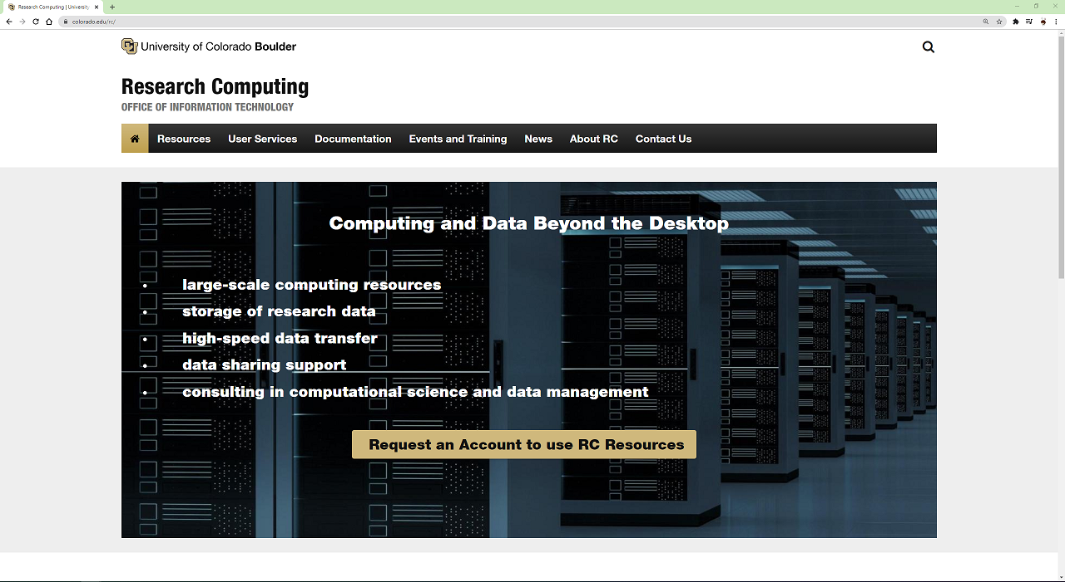
Getting an RC Account
Click here to get started!

Slide 7
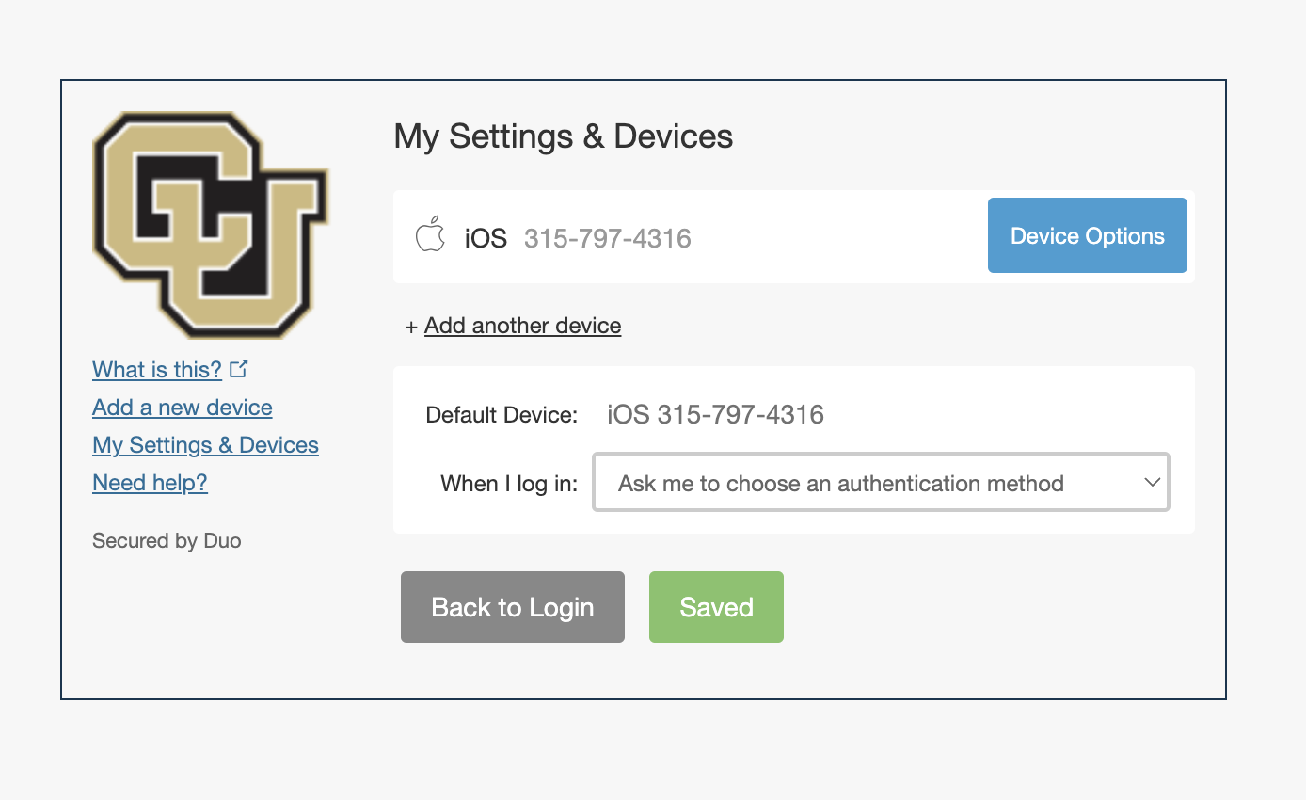
Duo Accounts
After requesting your account you will need to enroll in Duo 2-factor authentication
You can enroll, re-enroll, change devices, and manage your Duo account by visiting the CU Duo self-service portal at https://duo.colorado.edu

Slide 8
Accessing RC Services
There are numerous ways to access RC Resources from your local machine
Command line (Most common for Jobs)
Open OnDemand
Globus (if just managing files!)
Globus is probably the easiest solution when accessing files your files on RC resources

Slide 9
Access through the Command Line
Other users may find the use of Globus to be clunky when wanting to check on their files.
Users can log into RC servers on their local machines by opening a terminal and running the command:
ssh <your-username>@login.rc.colorado.edu

Slide 10
Basic Navigation Commands
Change directories
List contents of a directory
Print current working directory
cd <relative-or-full-path>
ls <optional-path>
pwd

Slide 11
RC Filesystem
As with most Linux distributions, after logging into RC resources you will be placed in your RC home directory.
/home/$USER
RC’s file system is broken up into 4 major components
/home – 2GB
/projects – 250GB
/scratch/alpine – 10TB
/pl/active or /pl/archive (Petalibrary)
backups occur regularly on /home and /projects
/scratch/alpine- files are deleted 90 days after creation

Slide 12
Data transfers on Alpine
Data transfers to Alpine can be performed on login* or Alpine nodes.
Transfers are handled the same way as on Summit
Shared Directories
Accessible in normal locations
Scratch
Fastest storage access for Alpine compute
Parallel Filesystem (GPFS)
Directory: /scratch/alpine
*within reason!

Slide 13
RC Filesystem Map
/
/home
/projects
/scratch
/pl
/your-username
/your-username
/alpine
/active
/archive
/your-username
/your-pl-allocation
/your-pl-allocation
You start here!

Slide 14
RC Data transfer nodes
In addition to the usual RC login points, we provide data transfer nodes (DTNs) for faster transfers.
The upcoming commands can utilize these nodes IF you are on CU's VPN.
Address to transfer to data transfer nodes:
<username>@dtn.rc.int.colorado.edu

Slide 15
Command line options (1)
SCP / Secure Copy
scp is a very simple file transfer command that allows users to transfer one file to another remote system.
Useful with small or quick file transfers
SFTP / Secure File Transfer Protocol
sftp is a similarly simple protocol that loads a user into a sftp prompt with both local and remote file systems accessible from a single prompt.
Useful for multiple/repetitive small file transfers.
scp file1 <username>@login.rc.colorado.edu:<remote-path> # using a login node
scp <username>@dtn.rc.int.colorado.edu:<path-to-file> <target-path> # using DTN while on campus network
sftp <username>@login.rc.colorado.edu # using a login node
sftp <username>@dtn.rc.int.colorado.edu # using DTN while on campus network

Slide 16
Command line options (2)
rsync
rsync is a popular Linux utility for updating changed files to a remote filesystem.
Useful when working on a file on both remote and local machines with modifications that need to be updated
Flags:
-v # verbose mode
-r # recursive (directory)
-t # sync based off timestamp
-c # sync changed files based on content
-a # archive mode
rsync -v file1 <username>@login.rc.colorado.edu:<remote-path>

Slide 17
Command line options (3)
rclone
rclone is a command line program to manage files on cloud storage. It is a feature rich alternative to cloud vendors’ web storage interfaces. Over 40 cloud storage products support rclone including S3 object stores, business & consumer file storage services, as well as standard transfer protocols. Rclone has powerful cloud equivalents to the unix commands rsync, cp, mv, mount, ls, ncdu, tree, rm, and cat.
https://curc.readthedocs.io/en/latest/compute/data-transfer.html#rclone
rclone copy rclonetest.csv aws_s3:testbucket/

Slide 18
Command line options (4)
sshfs
Mount a remote directory to a local Unix operating system!
Mac and Linux Exclusive:
SMB mounting
Universal mounting protocol that is built into every operating system
Contact RC to get this set up!
sshfs <username>@login.rc.colorado.edu:<path> <local-mountpoint>

Slide 19

OpenOnDemand
GUI approach to RC Resources!
http://ondemand.rc.colorado.edu/
File management
Create, Delete, Move, and Rename
File transfers
Upload and Download
Good for managing your files and conducting small file transfers without interacting with a command line.

Slide 20
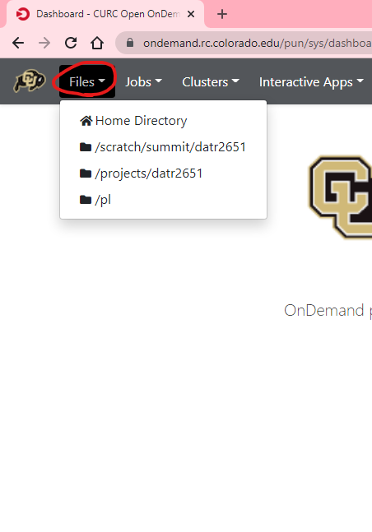
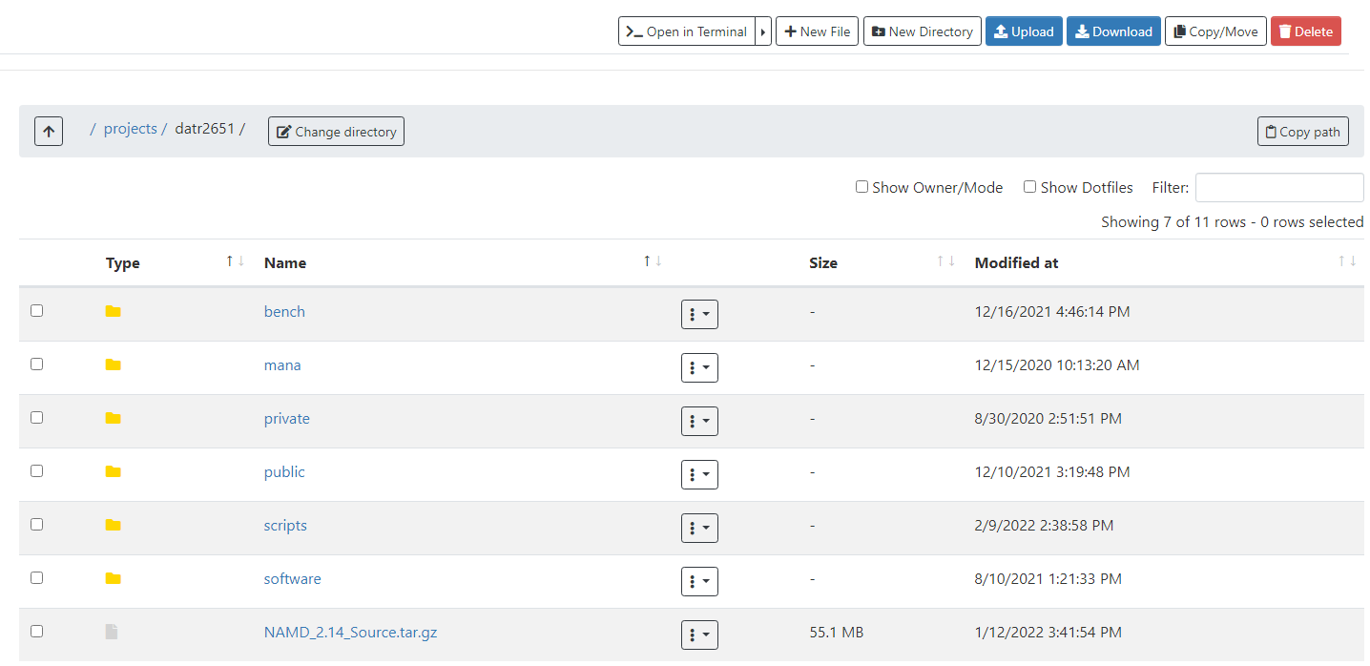

Slide 21

Globus
Globus
By far the most stable and recommended way for data transfers
Fast transfers
Transfers continue if a user disconnects
Web GUI option or Globus Connect Personal
Demo:

Slide 22
Globus Demo (1)
Globus login is simple and quick: https://app.globus.org
Select University of Colorado at Boulder under the dropdown menu
Login with your CU credentials
Continue with onscreen prompts until you are brought to the Globus WebGUI
Installing a Globus Endpoint on your local machine
Navigate down to Endpoints on the sidebar
Click create an endpoint on the top right of the page
Select your operating system and download the installer
Follow the prompts on the installer and complete the installation

Slide 23
Globus Demo (2)
Transferring Files can be done through the GUI
From the File Manager tab:
Click the “Two Panel” view button at the top right.
Click the top left Search bar.
Search “CU Boulder Research Computing” and select the end point.
Sign into Research Computing’s Endpoint
Click the right search bar
On the ‘Your Collections’ tab, choose the endpoint you created
Transfer your files!

Slide 24
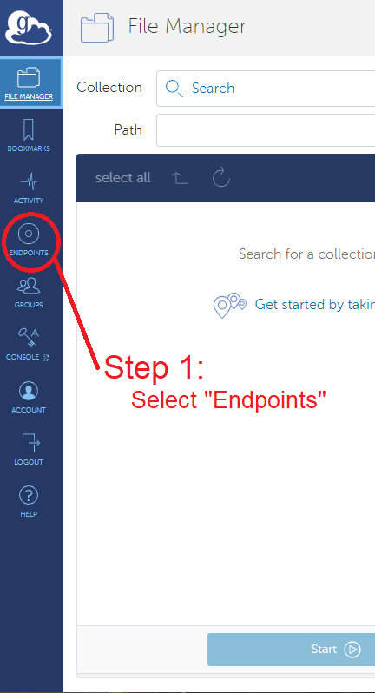
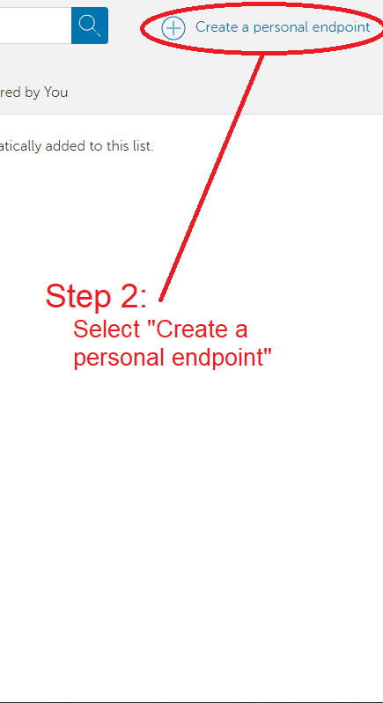
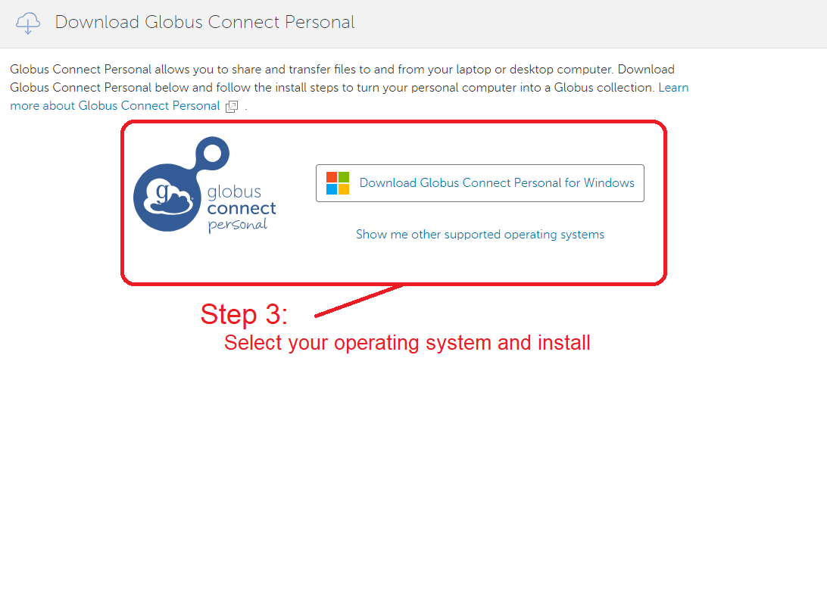

Slide 25
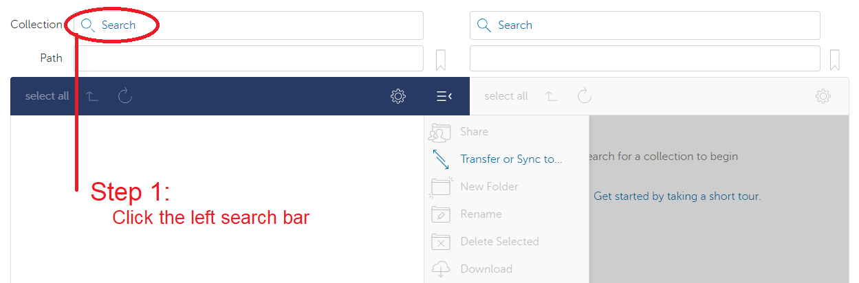
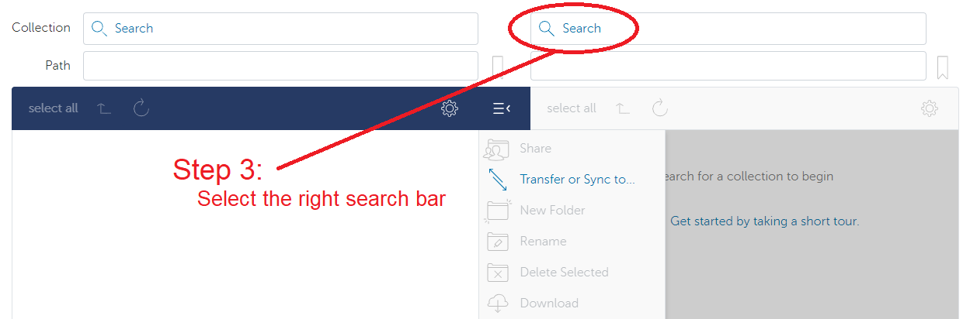
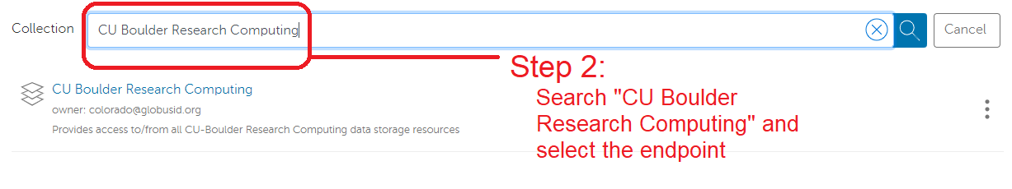
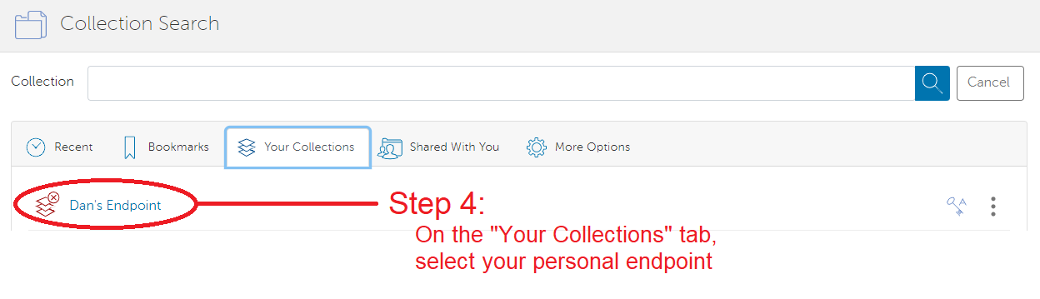

Slide 26
Sharing Data
Other RC Users
To share files that you own with other RC users, contact RC with a list of users you would wish to allow access
RC will place the chosen users in the owner’s group
The owner can then set up permissions in the space
On-premise collaborators can also access Petalibrary files with Globus Shared Endpoints
Off-premise collaborators
Off-premise collaborators can only access Petalibrary files through Globus Shared Endpoints

Slide 27
Unix Groups
Unix Groups
3 Levels of permissions:
User
Group
Other
All users have a group associated with their username
Permissions can be set for an individual file with the chmod command
chmod g+rx file.exe

Slide 28
Globus Shared Endpoints
Globus offers ‘shared endpoints’ which don’t require a user to have an account with RC.
RC provides this capability for easy access of Data.
Petalibrary exclusive!
Generates a shared collection that can be accessed with a link.
Can assign various permissions to specific users or all users withing Globus
More information on here: https://docs.globus.org/how-to/share-files/

Slide 29
Data Publishing with Petalibrary
Using Globus shared endpoints can be a great way to publish your data while maintaining the convenience of having it Petalibrary.
Example: https://scholar.colorado.edu/concern/datasets/9593tw13k

Slide 30
Petalibrary Notes
curc-quota – Research Computing tool to monitor disk usage.
Provides detailed summary of your core storage
Provides detailed summary of scratch space on compile and compute nodes
Also lists current capacity of all Petalibrary allocations you have access to
.cstats- usage statistics file for an allocation
cat /pl/active/<allocation_name>/.cstats
cat /pl/active/rcops/.cstats
Note: Confidential Data is unsupported and should not be stored on Petalibrary!
[userXXXX@login12 ~]$ curc-quota

Slide 31
Thank you!
Please fill out the survey: http://tinyurl.com/curc-survey18
Contact information: rc-help@colorado.edu
Check the RMACCForum: https://ask.cyberinfrastructure.org/c/rmacc/65

